Slide 1

ONENOTE
OneNote is like an e-book shelf with unlimited storage space. You can store your own e-books on this e-book shelf. The structure of each e-book is the same as that of ordinary paper books
SA9225404 吴语港

Slide 2
01
PART ONE Logical structure
CONTENT
02
PART TWO User needs
03
PART THREE Plugin

Slide 3
1
PART ONE Logical structure

Slide 4
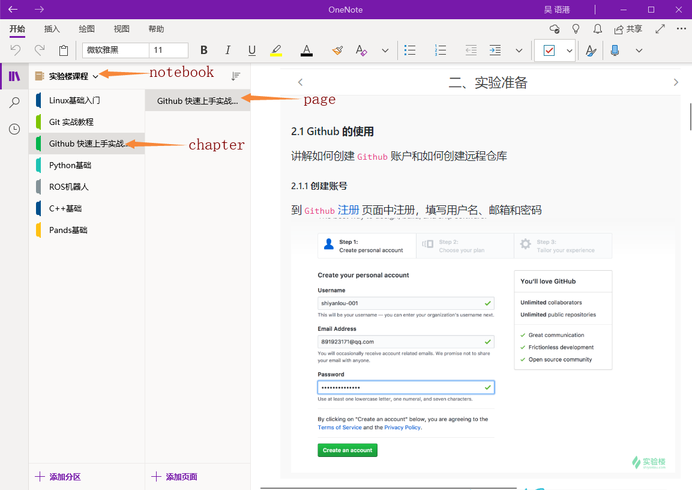
Logical structure
Onenote's notes are composed of three levels of structure, the highest level is the notebook, then the next level is the chapter, the smallest structure is the page, not only can be input by typing pictures, or even by stylus

Slide 5
2
PART TWO User needs

Slide 6
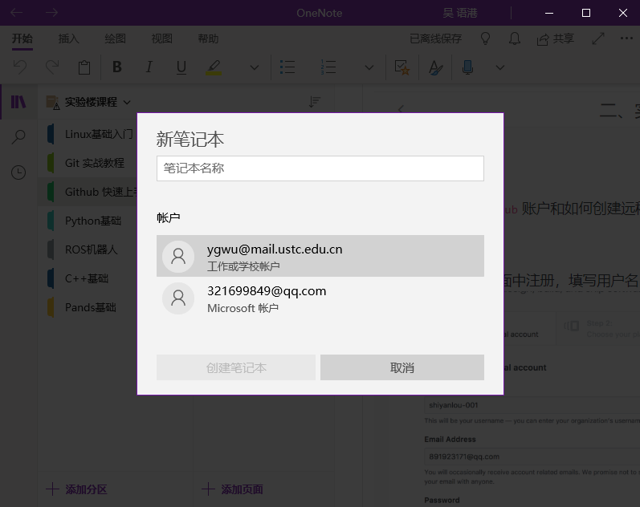
User needs ：Create notebook
There are two ways to save the notebook location: OneDrive cloud & local storage
It is recommended to use the OneDrive cloud storage method: real-time storage, convenient for multiple computers to work, data is not easy to lose

Slide 7
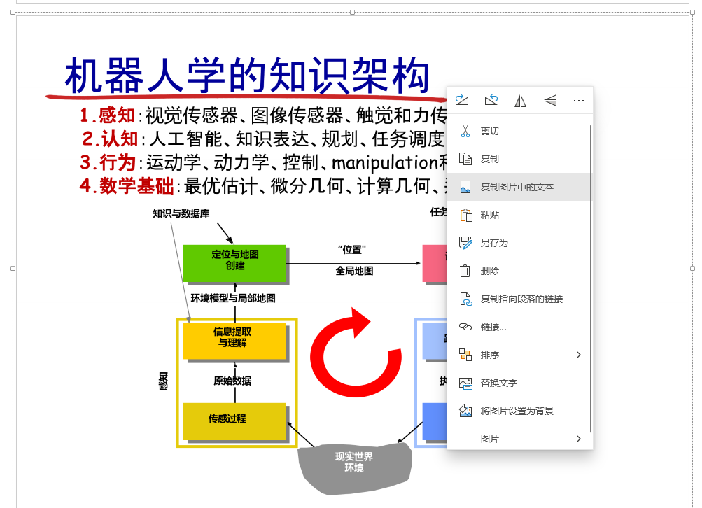
User needs ：Take words from the screen
OneNote can also extract the text in the picture. For example, there is a lot of content on a picture, but you do n’t want to record it by typing it yourself. Then you can put this picture in OneNote and use the text in the copied picture Can complete this operation

Slide 8
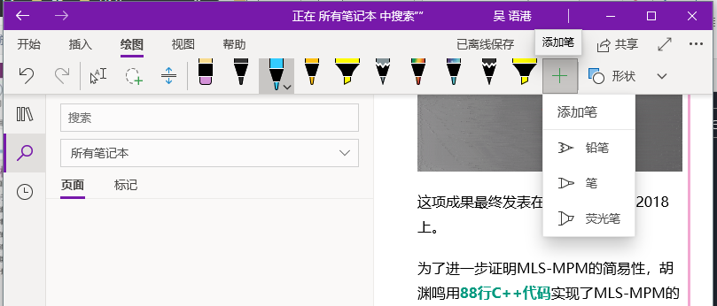
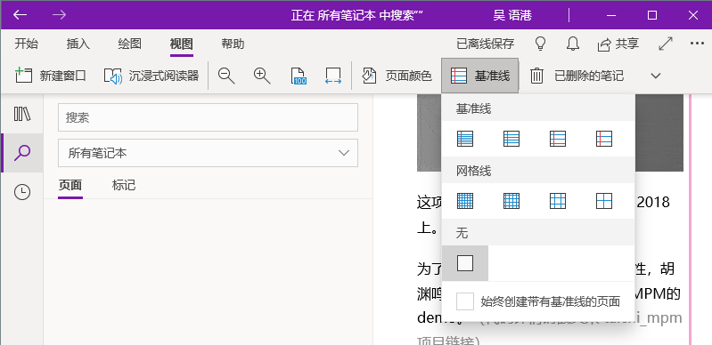
User needs
OneNote also has rich and powerful drawing tools, such as different types of pens with different thicknesses and different colors, so that you can maximize your creativity.
OneNote also has a very rich view tool. For example, you can make your paper have grid lines or baselines and can adjust the background color style of the paper.

Slide 9
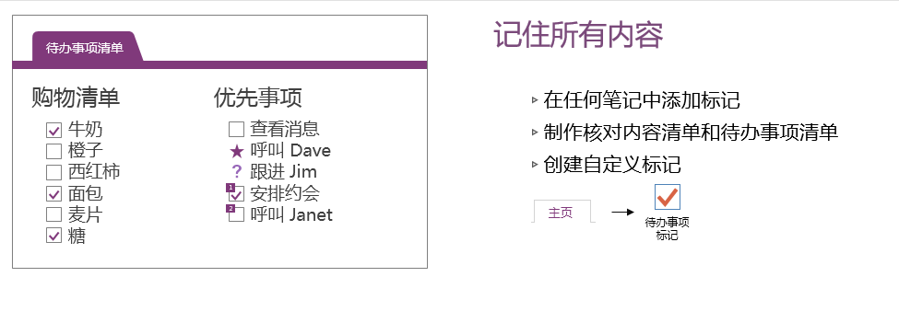
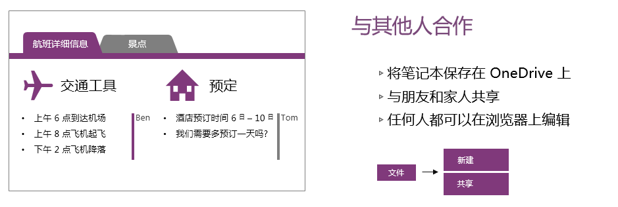
User needs
OneNote can also make a to-do list, you can write what you want to do on a list, and then you can check it after completion, not only that, but OneNote can also be edited with others and can be on different devices This is his best feature. The cross-platform feature allows you to have the same notebook between your devices

Slide 10
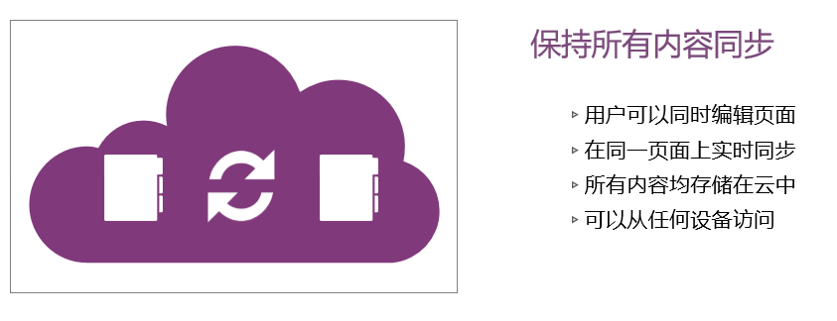
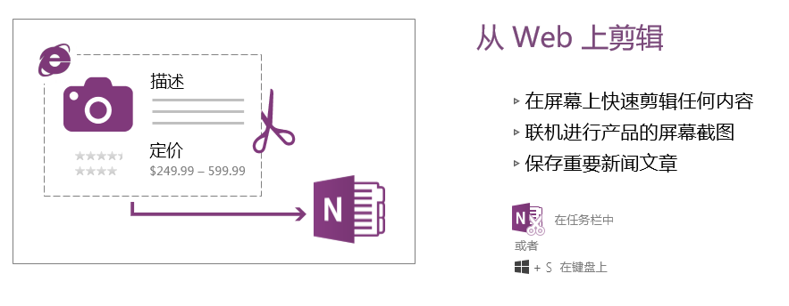
User needs
One of the most important features of onenote is that it can keep the notes on all devices synchronized, and can be stored on the cloud so that you can take notes wherever you go, which is very convenient.
And OneNote has a very convenient operation is that you can quickly edit any content on the screen, so that the speed and efficiency of your notes have been greatly improved.

Slide 11
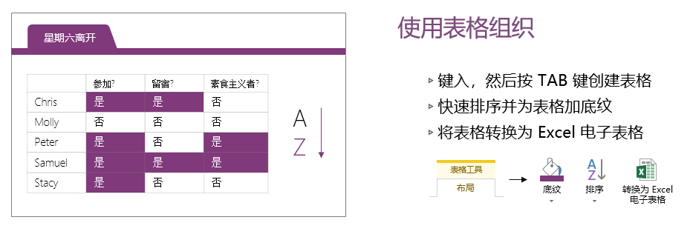
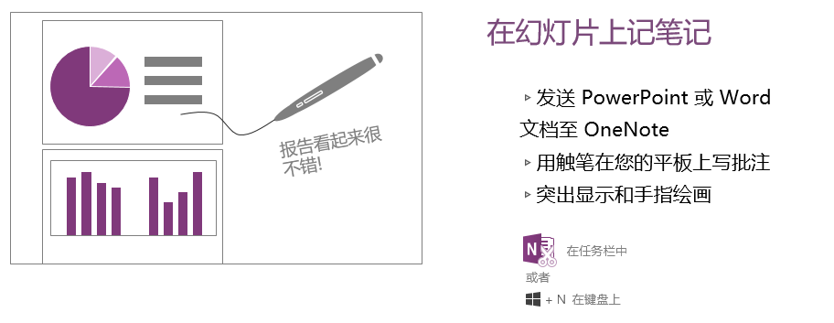
User needs
Of course, after all, OneNote is a product of Microsoft, so the collaboration between its software is very strong, you can use tables or slides in onenote.
Especially when editing some slides, you can use the stylus to draw and make notes, which is really convenient to highlight that this is a real notebook.

Slide 12
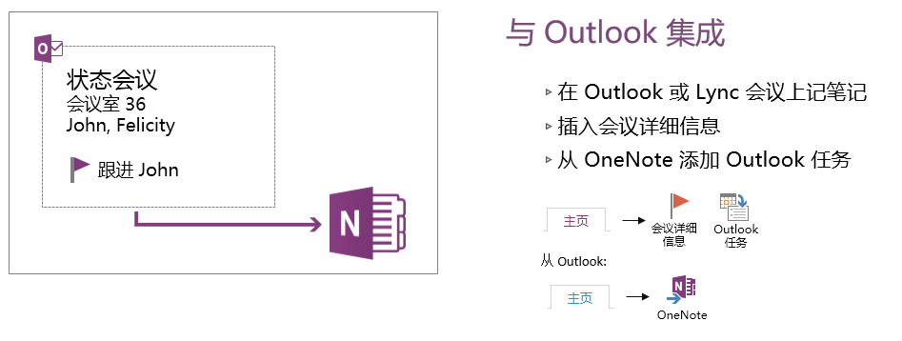
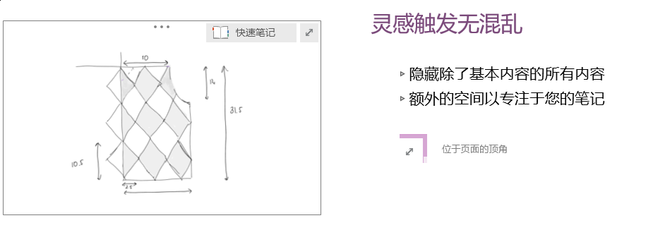
User needs
onenote can also be integrated with outlook, Of course, OneNote also has many small functions that need to be explored and accumulated slowly during use. This is indeed a very powerful assistant, which can help you accumulate knowledge in various directions, because he is a very powerful Powerful notebook can liberate your memory

Slide 13
3
PART THREE Plugin

Slide 14
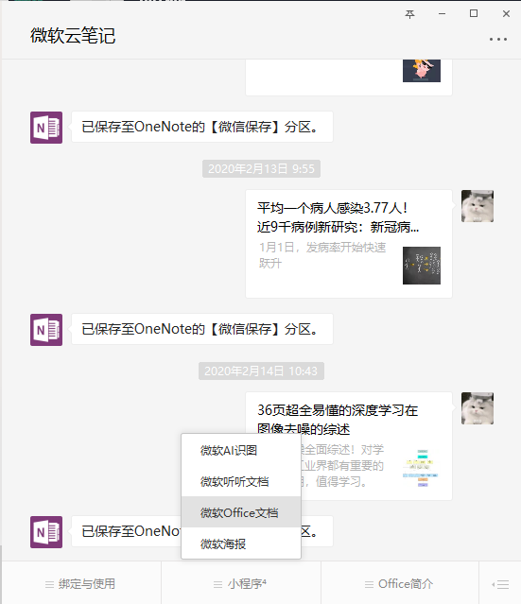
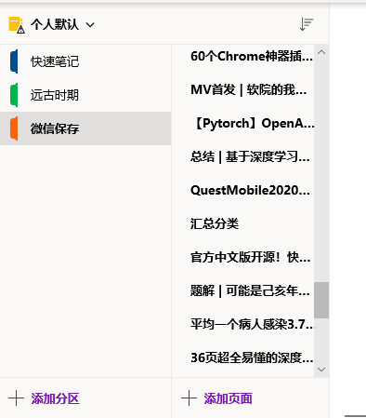
Plugin
OneNote also has a very useful plug-in function, that is, you saw an article in the WeChat public account. If you want to keep him, you can click the share button and send it to the Microsoft cloud note public account. In this case, your onenote This article will be saved to facilitate your taking notes, has it greatly improved your work and study efficiency?

Slide 15
THANK YOU !

